Slide 1

esse-Group 3
INEFFICIENT CAMPUS
RESOURCE MANAGEMENT
Proposed Engineering & IT Solutions for a Sustainable Campus
PRESENTED BY
John Martin Lijo
Jose Christopher
Joseph Jimmy
Joseph Jyothish
Joseph Mathew
Joseph T Thayyil

Slide 2
PROBLEM STATEMENT
esse-Group 3
PROBLEMS
RESULTING IMPACT
  Unmonitored Unmonitored electricity and water usage.
  Lights/AC operating in unoccupied rooms.
  Water leaks may remain undetected.
  Manual monitoring is slow and inconsistent.
  Lack of centralized, real-time resource data.
  Unnecessary resource wastage.
  Increased operational costs.
  Higher environmental impact.
  Delayed corrective action.
  Difficulty in making data-driven decisions.
WHAT WE NEED: A system that can monitor campus resources continuously, identify inefficient usage, and enable timely corrective action.

Slide 3
SUSTAINABILITY ANALYSIS
Group 3
esse-Group 3
SDG 7 (Affordable & Clean Energy)
  Promotes efficient energy use.
  Reduces unnecessary electricity consumption.
SDG 12(Responsible Consumption & Production)
  Encourages efficient resource use.
  Reduces resource wastage.
ISO 14001(Environmental
Management)
  Supports systematic monitoring.
  Helps improve environmental performance.
Overall Goal: Efficient resource management → Reduced wastage → Lower environmental impact.

Slide 4
Group 3
esse-Group 3
PROPOSED
SOLUTIONS

Slide 5
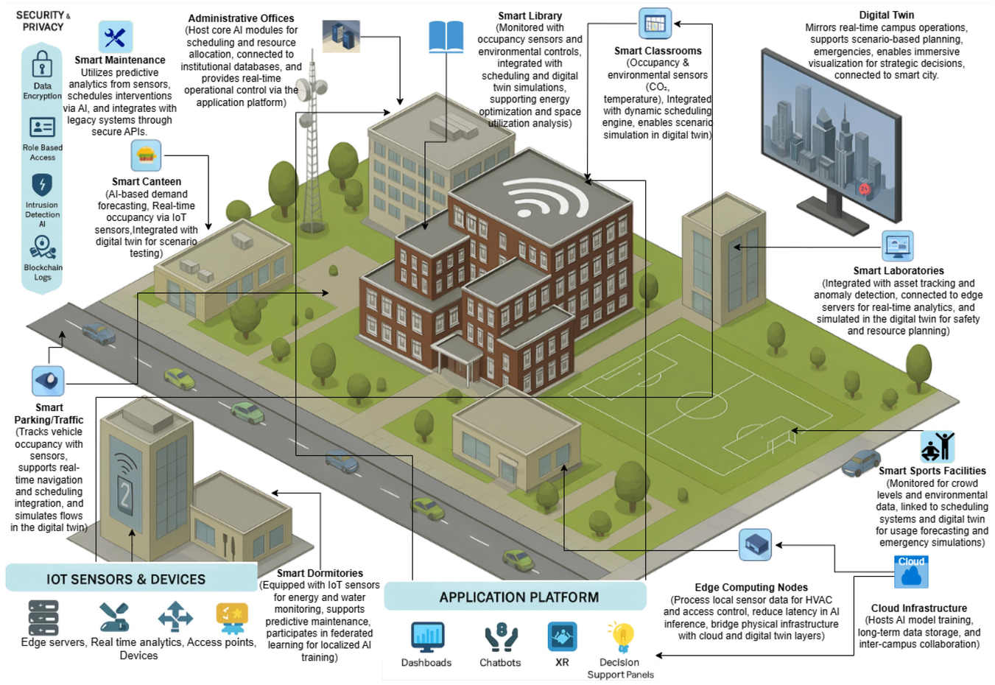
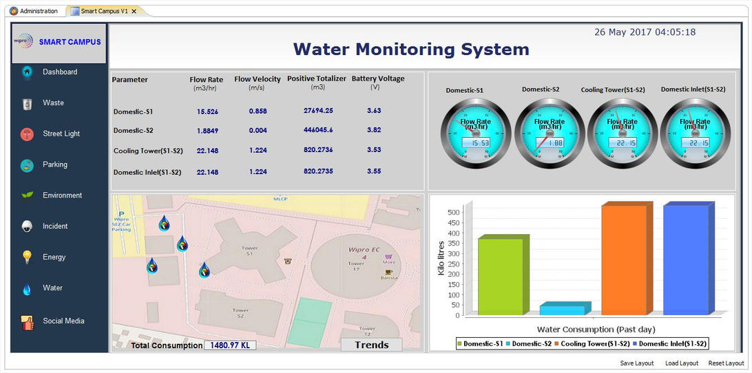
Group 3
esse-Group 3
SOLUTION 1
CORE OBJECTIVE
SYSTEM SCOPE
To design a centralized campus resource management solution that collects resource-use data through IoT sensors, analyses consumption patterns, and helps identify areas of inefficient resource usage for better decision-making.
The system focuses on selected campus facilities where electricity, water, waste, and occupancy can be monitored. It collects resource-related data, processes it through a centralized platform, and provides a web interface for viewing consumption patterns, resource efficiency, and unusual usage conditions.

Slide 6
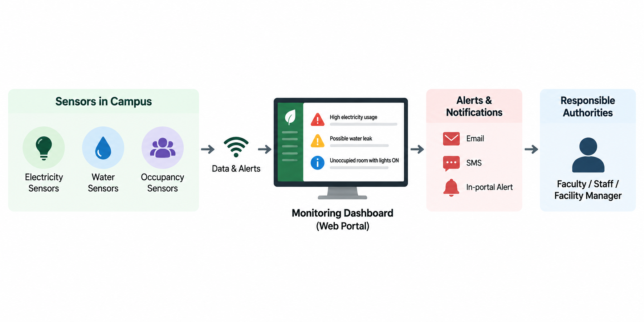
Group 3
esse-Group 3
SOLUTION 2
CORE OBJECTIVE
SYSTEM SCOPE
To develop a smart resource monitoring system that uses sensors and alert mechanisms to identify resource wastage on campus and provide timely information to responsible authorities for appropriate action.
The system will monitor campus resources such as electricity, water, and classroom occupancy using smart sensors, display real-time information and alerts through a web-based portal, and help responsible authorities take appropriate action to reduce resource wastage.

Slide 7

Group 3
esse-Group 3
SOLUTION 3
CORE OBJECTIVE
SYSTEM SCOPE
To implement a time-based electrical load-shedding system that forcefully curtails post-operational power consumption to eliminate after-hours phantom energy waste.
Integrating programmable digital timers and heavy-duty electromagnetic relays at the main distribution boards to automatically sever circuit continuity at pre-defined operational deadlines.

Slide 8

Group 3
esse-Group 3
SOLUTION 4
CORE OBJECTIVE
SYSTEM SCOPE
To deploy an IoT-based predictive resource allocation system that automates campus utility management, eliminates phantom electrical loads and water leaks, and drastically curtails institutional carbon footprint.
Integrating distributed ESP32 microcontrollers, passive infrared occupancy sensors, and digital flow meters to substitute error-prone manual audits with deterministic, automated environmental compliance under ISO 14001.

Slide 9
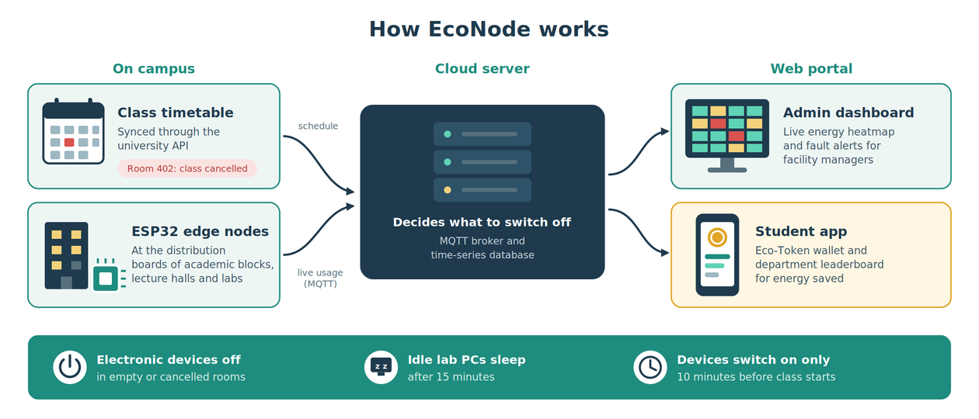
Group 3
esse-Group 3
SOLUTION 5
CORE OBJECTIVE
SYSTEM SCOPE
To deploy a timetable-synchronized energy management system that automatically powers down HVAC and lighting in unused rooms, puts idle lab computers to sleep, and motivates students through a gamified Eco-Token reward economy, cutting campus energy consumption by 15–20%.
Integrating ESP32 edge nodes at building distribution boards, an MQTT and time-series database backend, and a React.js web portal linked to the university timetable API. It covers lecture halls, computer labs and student hostels, and provides automated control, admin dashboards and student token wallets with leaderboards.

Slide 10
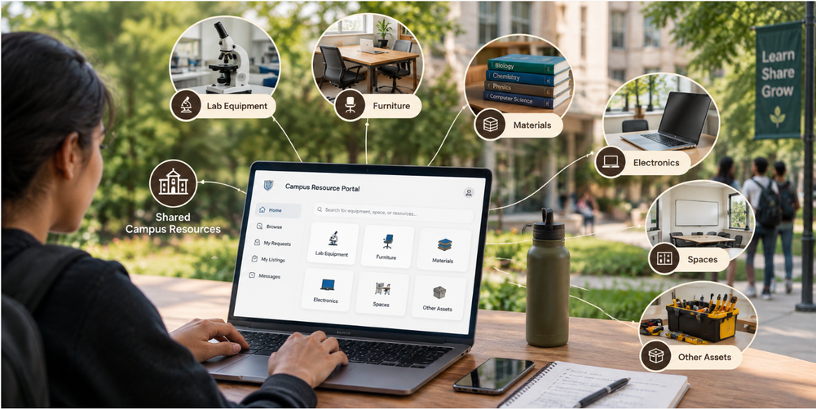
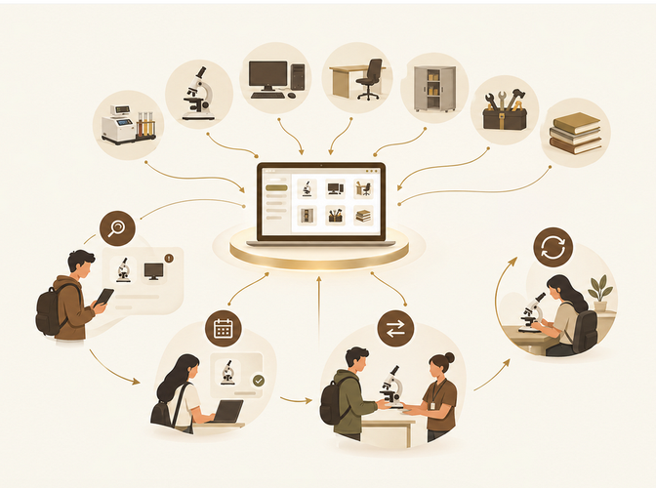
Group 3
esse-Group 3
SOLUTION 6
CORE OBJECTIVE
SYSTEM SCOPE
To create a smart campus resource-sharing system that identifies underutilized equipment, furniture, laboratory materials, and other assets, and reallocates them to users who need them, reducing unnecessary purchases and resource wastage.
Integrating a centralized digital inventory with a web/mobile portal for departments and students to list, search, request, reserve, transfer, and return campus resources. A smart matching engine recommends available resources based on requirements, location, availability, and condition, while an administrative dashboard tracks utilization, maintenance, transfers, and cost savings.

Slide 11

Group 3
esse-Group 3
So which solution did we select?
  We decided to go with Solution 4.
  It has a simple, UI -friendly design.
  It uses precise calculation to give the exact answer.
  It helps reduce water and power wastage by reporting issues.

Slide 12
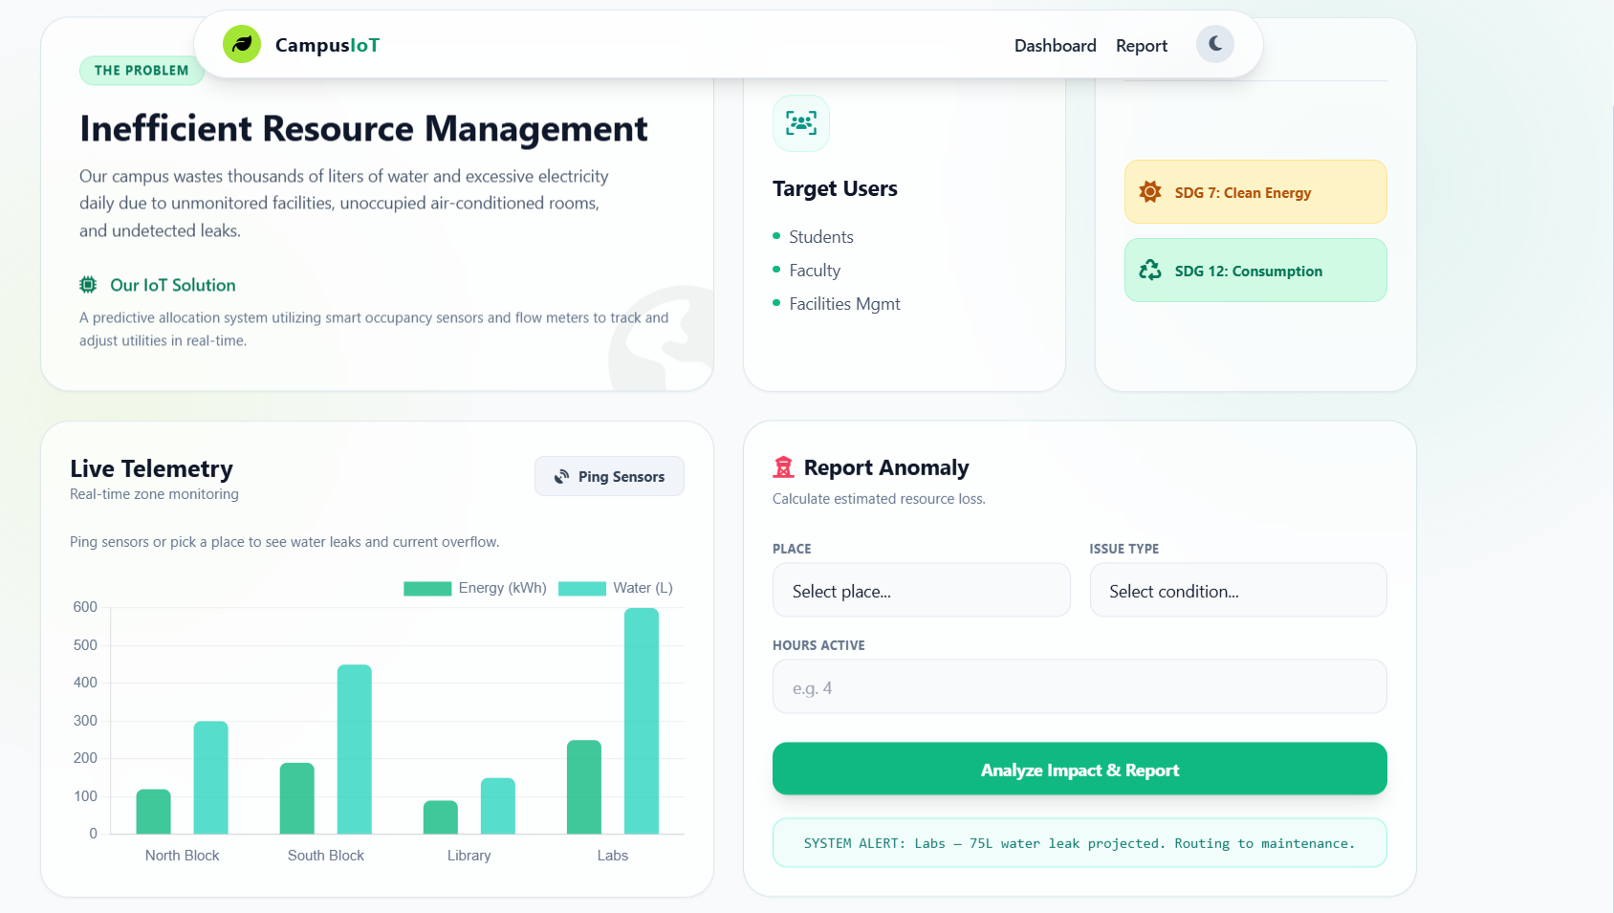
SCREENSHOT
Group 3
esse-Group 3

Slide 13
esse-Group 3
THANK YOU
PRESENTED BY
John Martin Lijo
Jose Christopher
Joseph Jimmy
Joseph Jyothish
Joseph Mathew
Joseph T Thayyil

